Slide 1

G2M Case Study
Virtual Internship
12-October-2022
Kushal Samani

Slide 2
BACKGROUND –G2M(CAB INDUSTRY) CASE STUDY
XYZ is a private equity firm in the US. Due to remarkable growth in the Cab Industry in the last few years and multiple key players in the market, it is planning for an investment in the Cab industry.
Objective: Provide actionable insights to help XYZ firm identify the right company for investment.
The analysis has been divided into four parts:
Data Exploration.
Data Visualization.
Comparing both Cabs along various KPIs.
Investment recommendations.

Slide 3
DATA EXPLORATION
18 Features( including 4 derived features)
Timeframe of the data: 2016-01-02 to 2018-12-31
Total data points: 359,392
Assumptions:
It is assumed that there is no repetition of transactions in the final data frame.
It is assumed that Income does not play a significant role in deciding which cab the user will book.
It has been assumed that Company, Customer ID, Income, Transaction ID, Date of Travel, Cost of Trip, Payment Mode, Population, Users, Profit, Profit/km, Year, and Price/Km do not play a role in an individual’s decision of booking a cab.
Cab_Data.csv
Customer_ID.csv
Transaction_ID.csv
City.csv
Final df

Slide 4
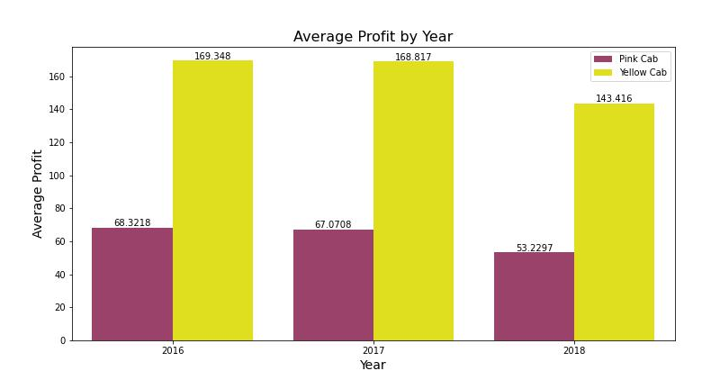
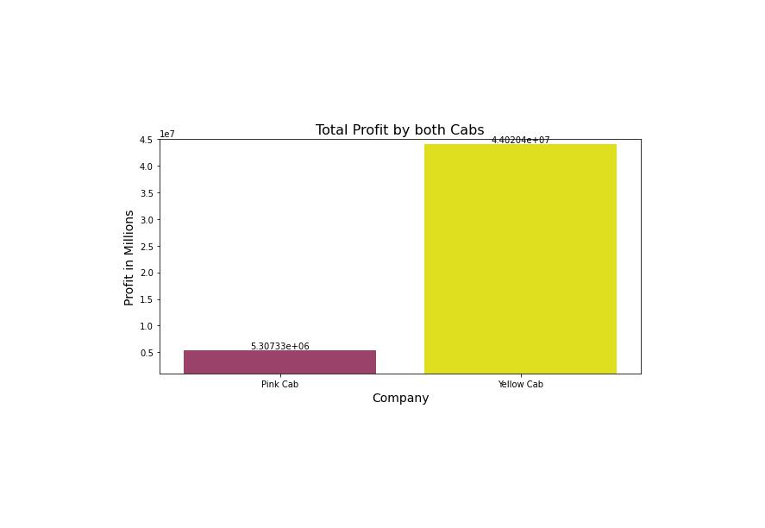
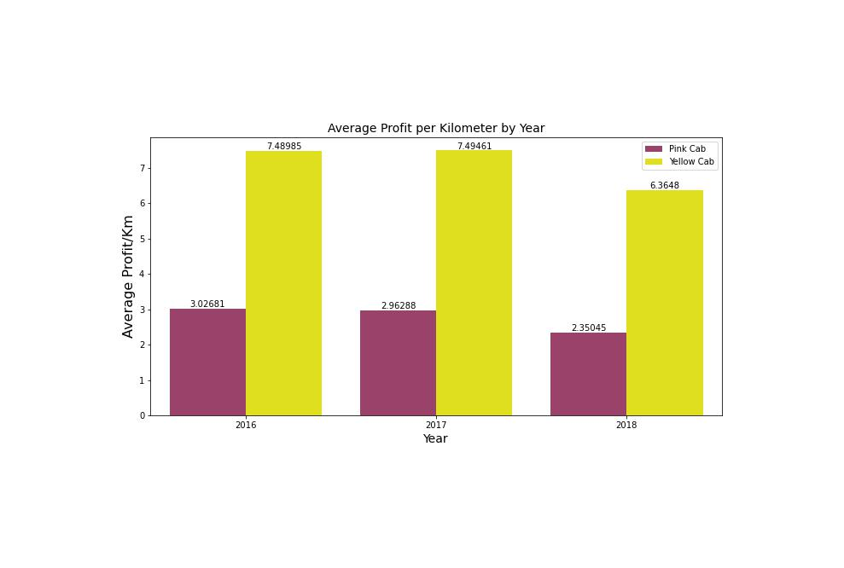
Profit Analysis
DATA VISUALIZATION: PROFIT
Yellow Cab is 8 times more profitable than Pink Cab.

Slide 5
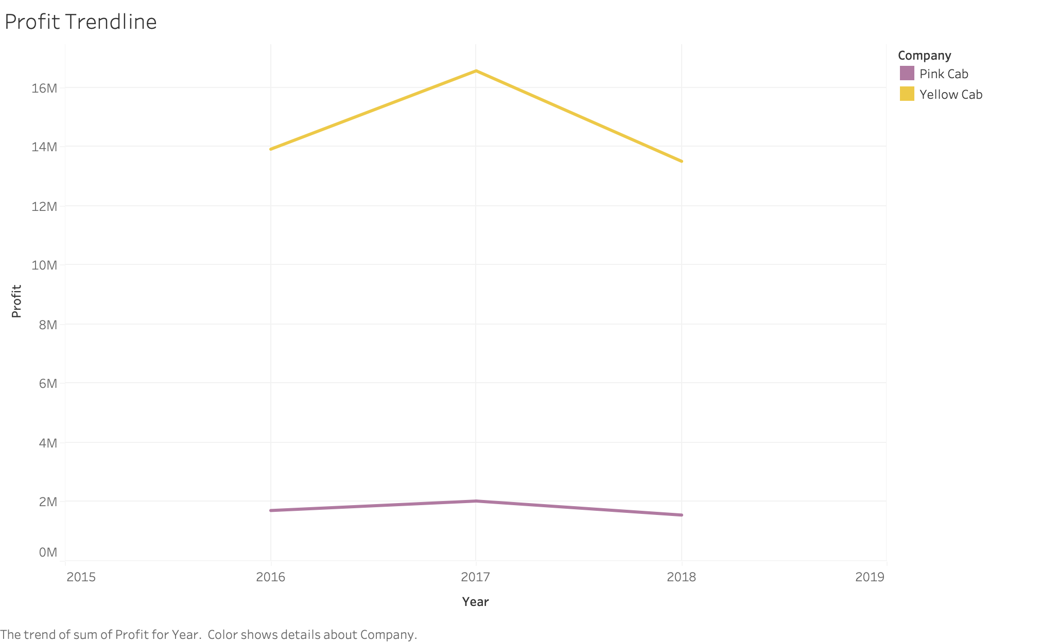
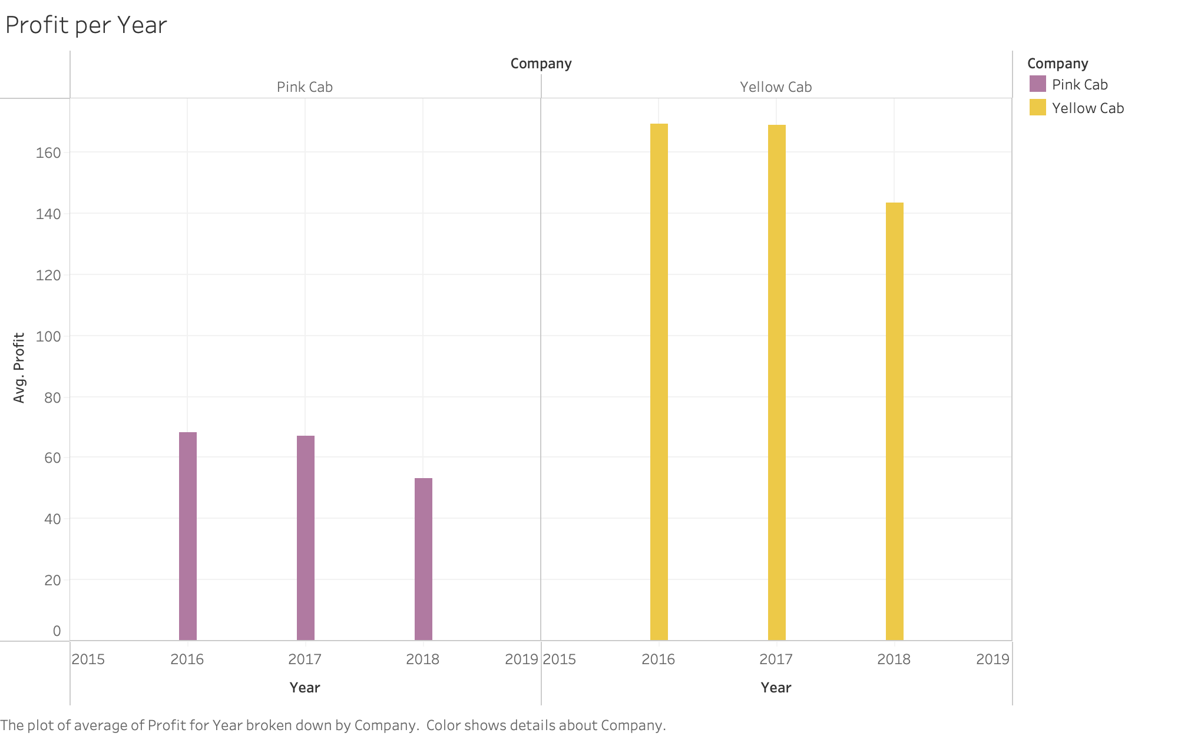
YEARLY PROFIT ANALYSIS

Slide 6
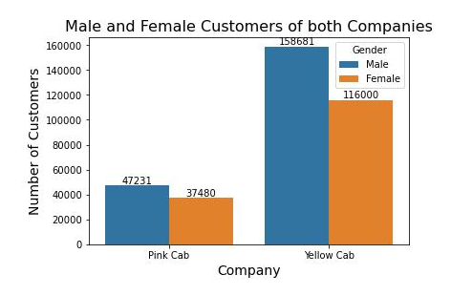
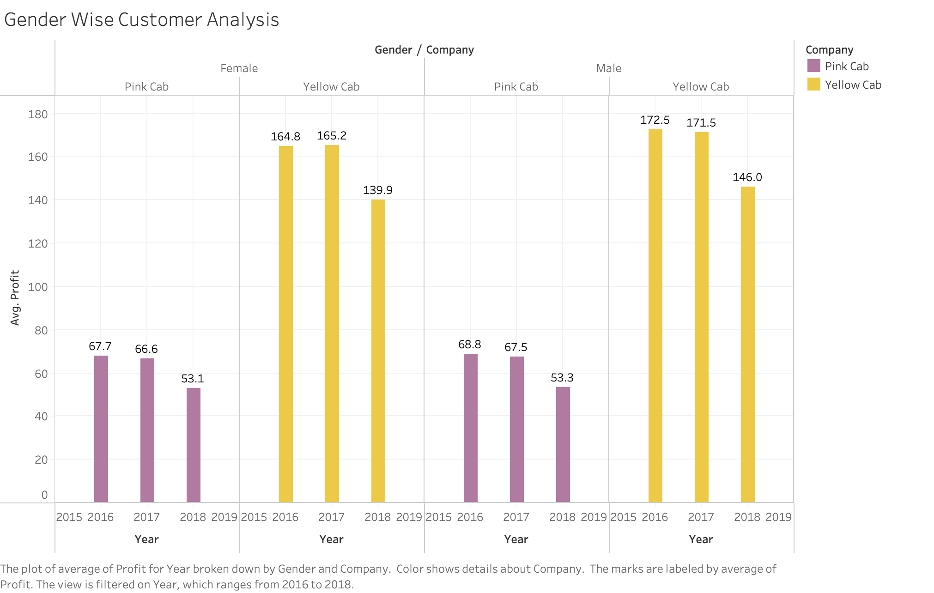
GENDER-WISE CUSTOMER ANALYSIS
There is no imbalance between genders while selecting a specific cab. Hence, it can be concluded that gender does not play a big role in deciding the cab.

Slide 7
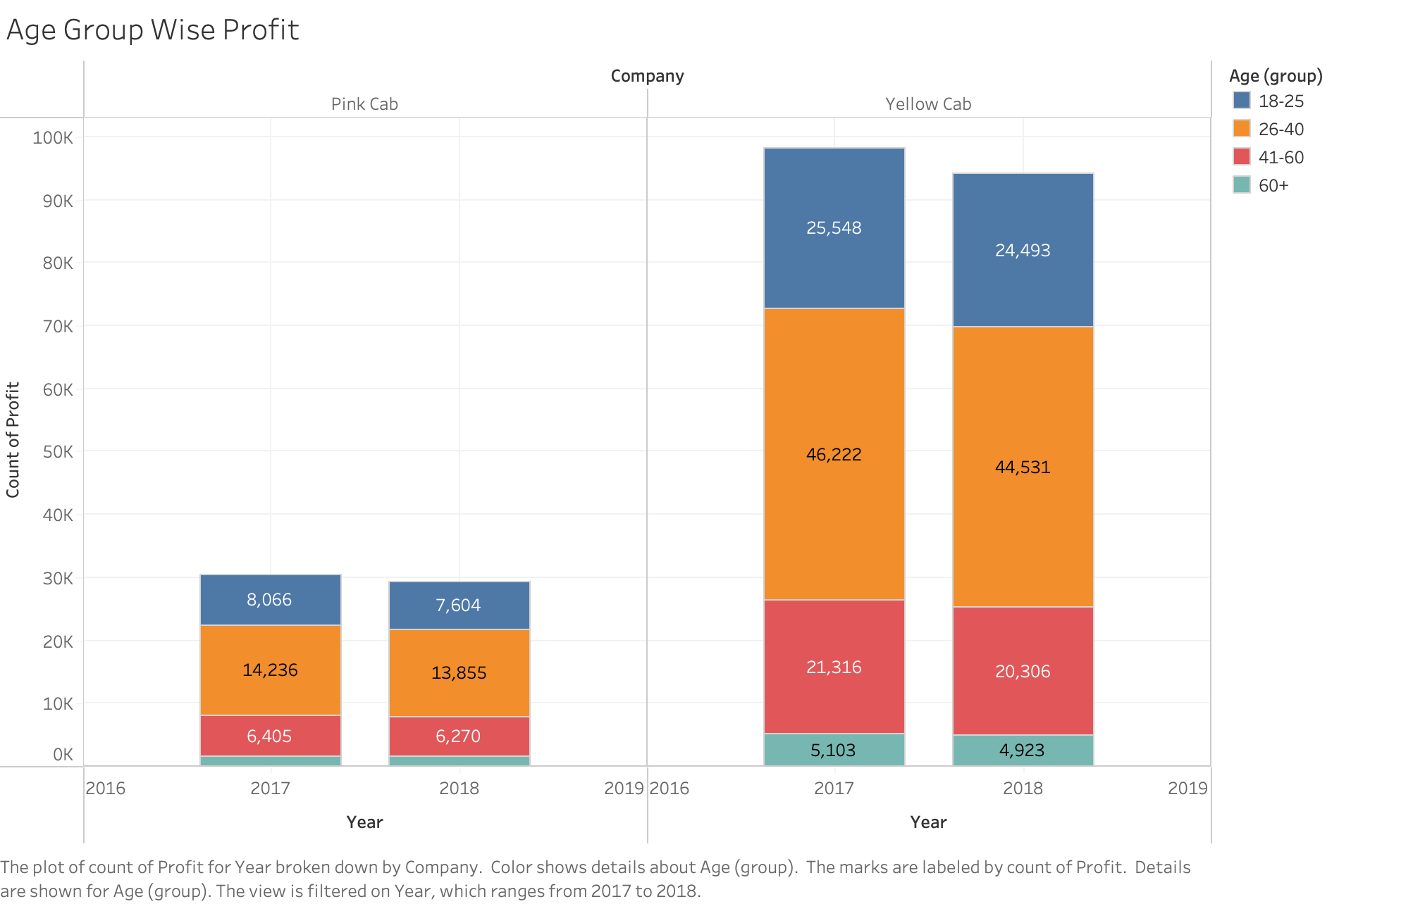
AGE GROUP-WISE PROFIT ANALYSIS

Slide 8
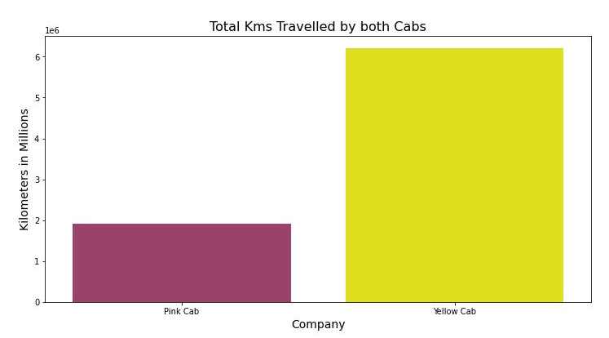
TOTAL KM TRAVELLED BY BOTH CABS
Yellow Cab shows more kilometers travelled as compared to Pink Cab.
It can be inferred that Yellow Cab has more business.

Slide 9
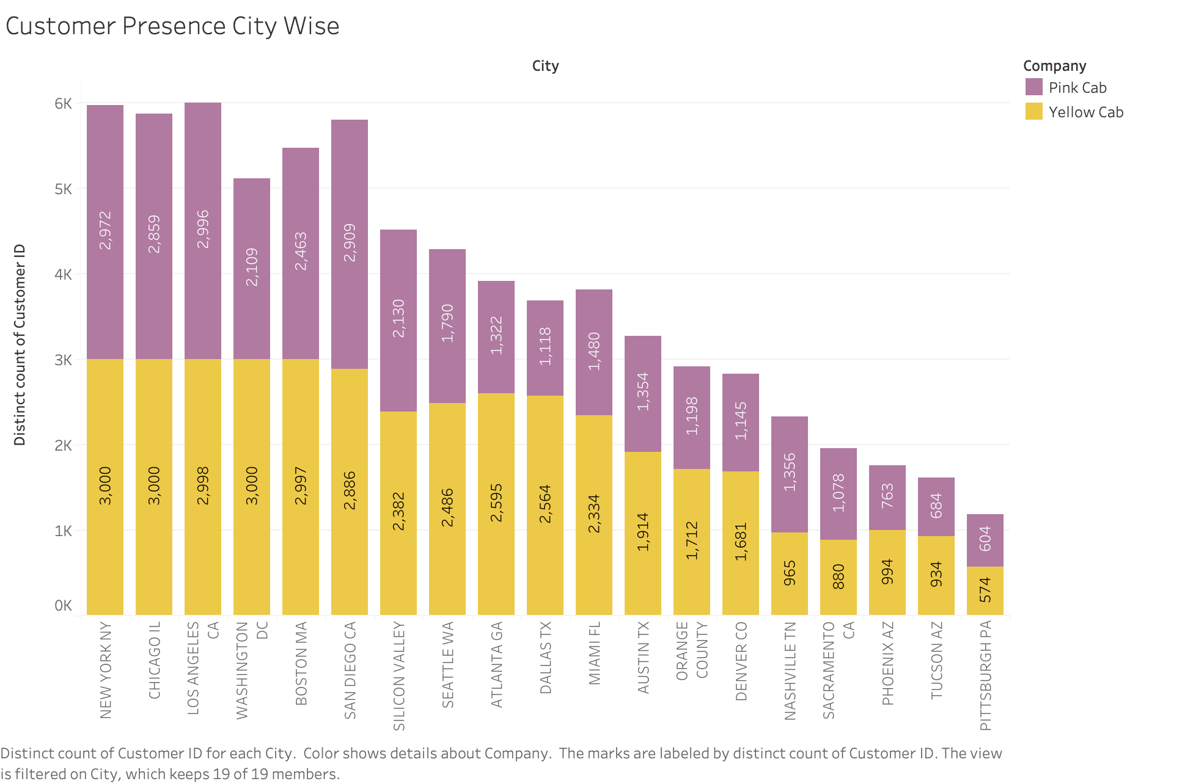
CUSTOMER PRESENCE CITY WISE
Pink cab has higher customer reach in 4 cities as compared to Yellow cab:
Pittsburgh
Sacramento
Nashville
San Diego

Slide 10
RECOMMENDATION
We have evaluated both the cab companies on the following points and found Yellow cab better than Pink cab:
Average Profit: Yellow cab’s total profit is more than eight times the total profit of Pink cab.
Average Profit per KM: Yellow cab’s average profit per km is almost three times the average profit per km of Pink cab.
Age-Wise Reach: Yellow cab has customers in all age groups, and it is also popular in the 60+ age group as equally as it is in the 18-25 age group.
Customer Reach: Yellow cab has a higher customer reach in 15 cities while Pink cab has a higher customer reach in 4 cities.
Total Kms Travelled: Yellow Cab shows more km travelled than Pink Cab. It can be inferred that Yellow Cab has more business and customers.
Based on the above points, our recommendation is to invest in YELLOW CAB.

Slide 11
Thank You

